Slide 1

Listeners
Listeners are logger/display elements of Apache JMeter. You need to add at least one listener to capture the results (response time, throughput etc ) of the test plan and display it.

Slide 2
Listeners
Listeners
JMeter provides many kinds of listeners like graphical, tabular, flat file etc.
Listeners differ only in the way they display result. However, all listeners create identical log files.
You can select the fields you want to log like response times, urls, response headers, etc using Configure button. You can also select whether to store the result in xml or csv format.

Slide 3
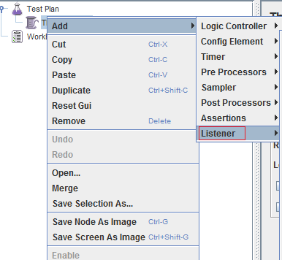
Listeners
A log file created by one listener can be reopened by another listener for a different display since data is logged identically by all listeners.
Listeners can be added anywhere in the test, including directly under the test plan. They will collect data only from elements at or below their level.
Note that Listeners are processed at the end of the scope in which they are found.

Slide 4
Listeners
Types of Listeners
Some JMeter Listeners are :
Simple Data Writer
Summary Report
View Results Tree
View Results in Table
Graph Results

Slide 5
Simple Data Writer
Listeners
This listener can record results to a file but not to the
GUI.
It is meant to provide an efficient means of recording
data by eliminating GUI overhead.
When running in non-GUI mode, the -l flag can be
used to create a data file.

Slide 6
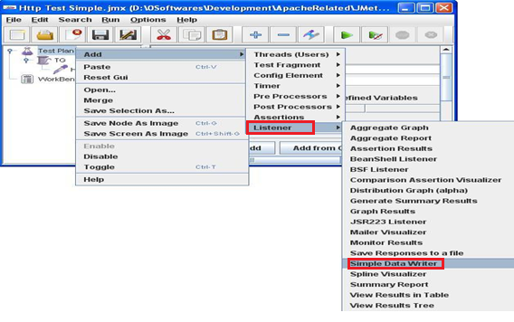
Listeners
Simple Data Writer
Let's see an example of Simple Data Writer in use:
Step 1: Create a Thread group and a sampler, then add a Simple Data Writer listener as shown in the below figure.

Slide 7
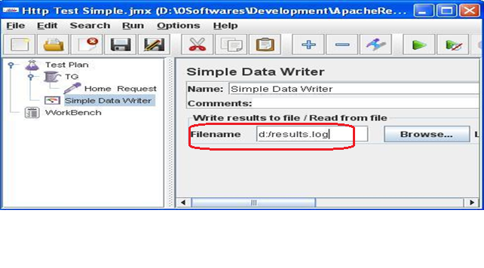
Listeners
Simple Data Writer
Step 2: Configure the filename Simple Data Writer as shown in the below figure

Slide 8
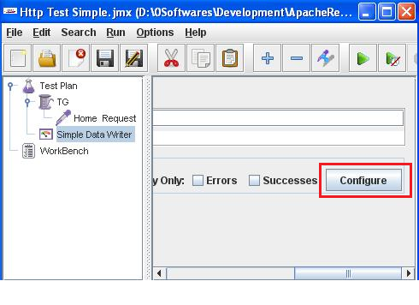
Listeners
Simple Data Writer
Step 3: Click on the Configure button, to log the fields.

Slide 9
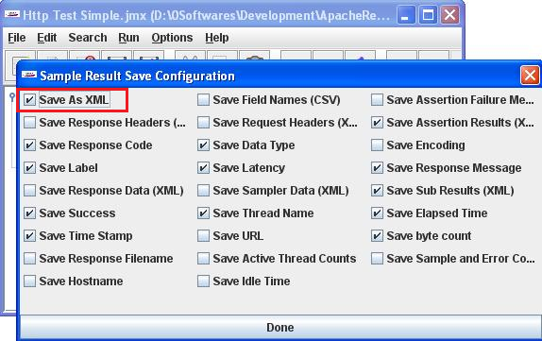
Listeners
Simple Data Writer
Step 4: After Clicking the Configure button, another screen displays in that select and configure the fields that you want to log, to select xml or csv format for results file etc.

Slide 10
Listeners
Simple Data Writer
The below is the Default output file shows the contents of log file created by Simple data Writer with default settings
01.<?xml version="1.0" encoding="UTF-8"?>
02.<testResults version="1.2">
03.<httpSample t="318" lt="176" ts="1347687818528" s="true" lb="Home Request" rc="200" rm="OK" tn="TG 1-1" dt="text" by="12860"/>
04.<httpSample t="335" lt="201" ts="1347687818530" s="true" lb="Home Request" rc="200" rm="OK" tn="TG 1-3" dt="text" by="12828"/>
05.<httpSample t="355" lt="230" ts="1347687818530" s="true" lb="Home Request" rc="200" rm="OK" tn="TG 1-4" dt="text" by="12816"/>
06.<httpSample t="376" lt="259" ts="1347687818529" s="true" lb="Home Request" rc="200" rm="OK" tn="TG 1-2" dt="text" by="12876"/>
07.<httpSample t="406" lt="285" ts="1347687818531" s="true" lb="Home Request" rc="200" rm="OK" tn="TG 1-5" dt="text" by="15982"/>
</testResults>

Slide 11
Listeners
Simple Data Writer
The below is the output file shows in csv format (the filed Save as XML un-checked) with http urls (the field Save Url checked)
timeStamp,elapsed,label,responseCode,responseMessage,threadName,dataType,success,bytes,URL,Latency
1347687937244,319,Home Request,200,OK,TG 1-1,text,true,12844,http://www.example.com/,176
1347687937246,337,Home Request,200,OK,TG 1-5,text,true,12828,http://www.example.com/,202
1347687937245,358,Home Request,200,OK,TG 1-3,text,true,12860,http://www.example.com/,232
1347687937246,377,Home Request,200,OK,TG 1-4,text,true,12848,http://www.example.com/,259
1347687937247,396,Home Request,200,OK,TG 1-2,text,true,12848,http://www.example.com/,286

Slide 12
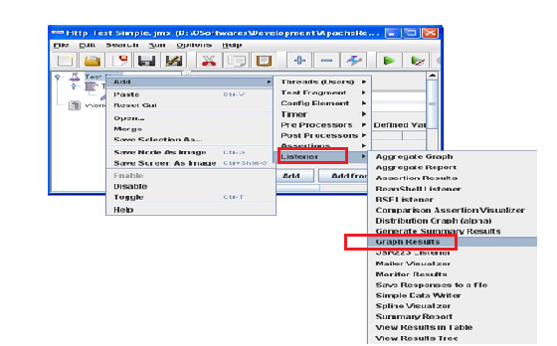
Graph Results Listener
Listeners
The Graph Results listener generates a simple graph that plots all sample times
Let's see an example of Graph Results listener in use.
Step1: Add a Graph Results Listener to a thread group or sampler as shown in the figure

Slide 13
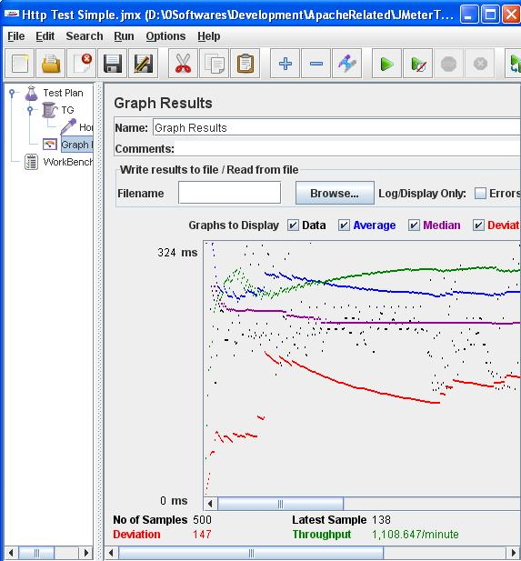
Listener
Graph Results Listener
Step 2: Now runs the test plan, the below figure shows the graph plotted by the Listener

Slide 14
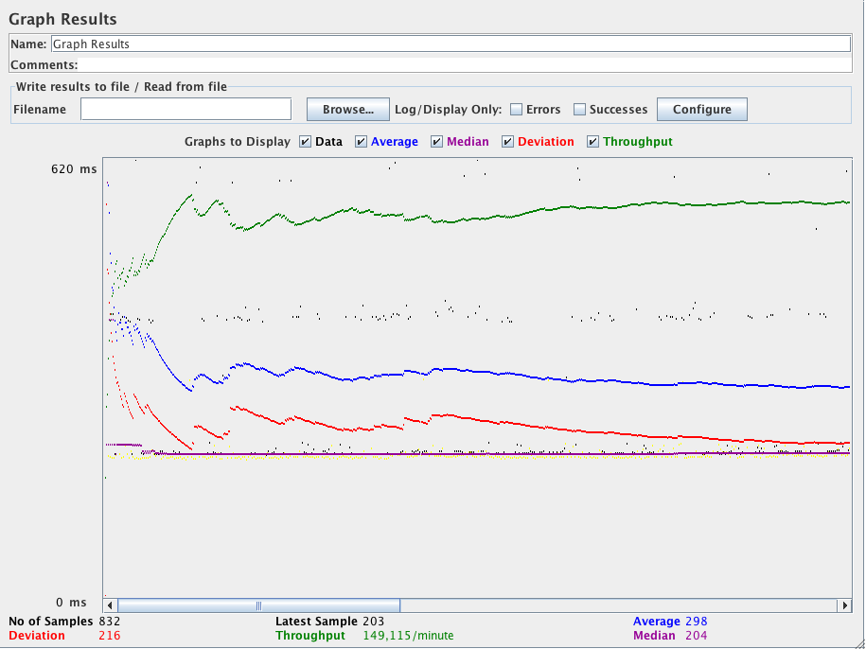
Listeners
Graph Result Listener
Step 3: The Graph Results listener generates a simple graph that plots all sample times. Along the bottom of the graph, the current sample (black), the current average of all samples(blue), the current standard deviation (red), and the current throughput rate (green) are displayed in milliseconds.

Slide 15
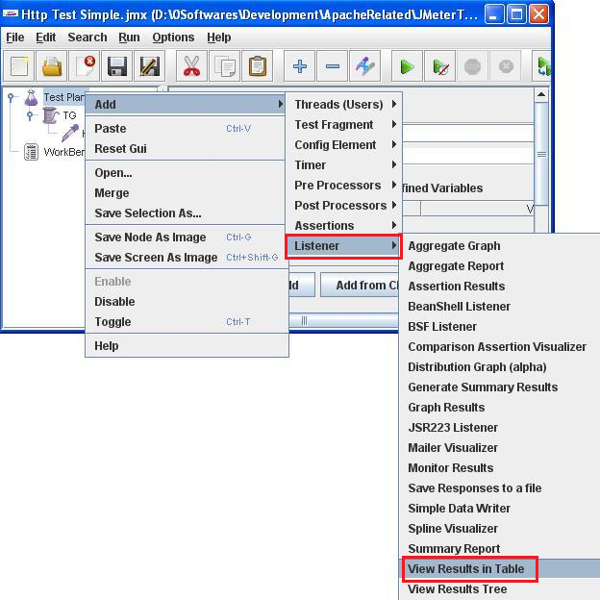
Listeners
View Results in Table
The View Results in a Table shows the results of test plan in tabular format
Let's see an example of this listener in use
Step 1: Adding a View Results in a Table listener

Slide 16
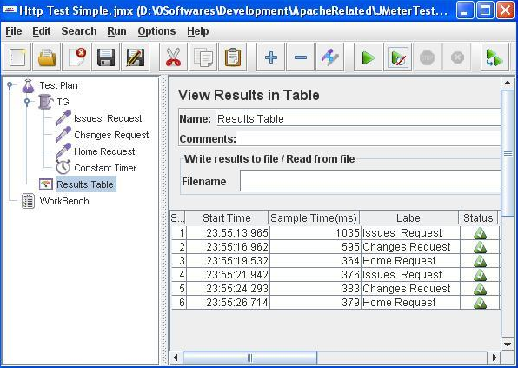
Listeners
View Results in Table
Step 2 : Table displayed by the Listener

Slide 17
Listeners
View Results in Tree
The View Results Tree shows a tree of all sample responses, allowing
you to view the response for any sample.
In addition to showing the response, you can see the time it took to
get this response, and some response codes
Let's see an example of this listener in use.

Slide 18
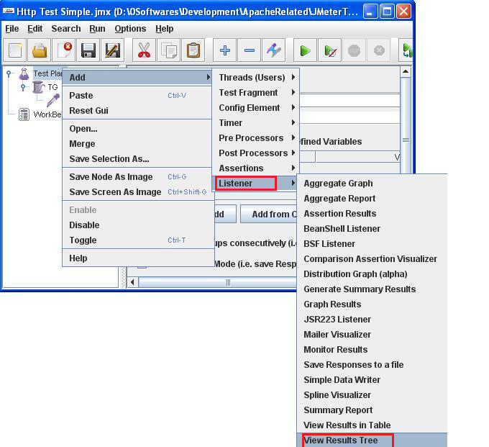
Listeners
View Results in Tree
Step 1 : Adding a View Results in a Tree listener

Slide 19
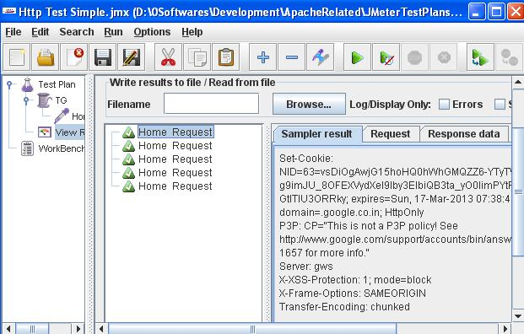
Listeners
View Results in Tree
Step 2 : Tree displayed by this listener. Notice that complete details (http request & response ) of all http requests

Slide 20

Thank You

